Slide 1
How to Enjoy Your Youth
Ecclesiastes 11:7–12:7
Dr. Rick Griffith • Crossroads International Church Singapore
CICFamily.com • BibleStudyDownloads.org
Notes:
Today we see how to enjoy your youth.

Slide 2
Are you a youth?
Notes:
But are you a youth? How would you know?

Slide 3
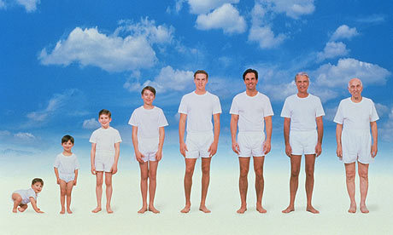
What are the stages of life?
Notes:
Are you a youth or not? That depends on how many stages of life exist. But in its most basic sense, I think life has essentially three stages…

Slide 4
Three Stages for Women
1. Annoying her dad
2. Annoying her husband
3. Annoying her son-in-law
Notes:
One person says that the three stages for women include: (1) annoying her dad, (2) annoying her husband, and (3) annoying her son-in-law.
What a sad evaluation that is!

Slide 5
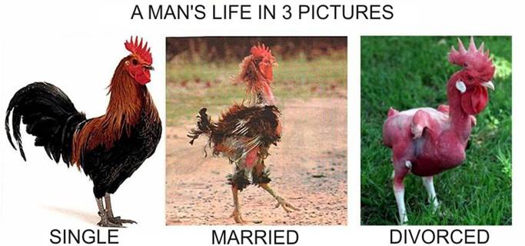
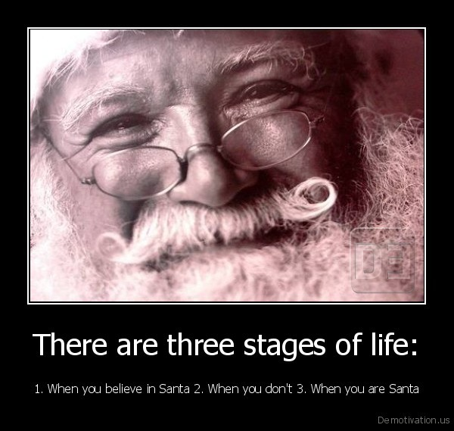
Three Stages for Men
1. You believe in Santa 2. You don't believe 3. You are Santa
Notes:
For men the stages are: (1) You believe in Santa, (2) You don't believe, and (3) You are Santa!
Seriously speaking, though…

Slide 6
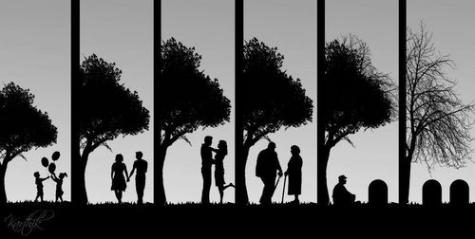
Life has three stages
What should youth pursue in life?
Youth 0-30
Youth 0-30
Mid-Life 30-60
Elderly 60-90
Notes:
Youth includes birth up to about age 30, since by that time most of us get married and are on our own.
Mid-life starts quite early in this depiction at age 30 and goes to age 60.
Nowadays many people live into their 80s and even their 90s, so old age would refer to ages 60-90.
What happens in stage 1 will certainly influence stages 2 and 3, so youth is crucial. This raises the important question: What should youth pursue in life? How should they live>

Slide 7
What can Solomon teach us?
Ecclesiastes
Notes:
What can Solomon teach us? Like us, Solomon had three stages of his life…

Slide 8
Solomon's three stages
Youth Song
Mid-Life Prov.
Elderly Eccl.
Notes:
He lived godly in his youth—knew true love (Song of Songs), asked for wisdom (1 Kings 3), built the temple (1 Kings 6), etc.
He got sidetracked in middle age—with political links to 1000 women and other profitless pursuits we saw in Ecclesiastes 2—yet he likely wrote Proverbs then.
He now shares the wisdom he gained in his old age—work and wisdom don't last (Eccl.).

Slide 9
It's time for
ECCLESIASTES
Notes:
How does today’s passage fit into the book?

Slide 10
What does this book address?
Q
Q
Q
Q
Q
Q
Q
Q
Q
Q
Q
Q
Q
Q
Q

Slide 11
In my opinion
. . . . .

Slide 12
. . . . a thousand and one things!

Slide 13
But with careful reading, you will find 3 fleeting areas of life:

Slide 14
Fleeting nature of human achievement
1

Slide 15
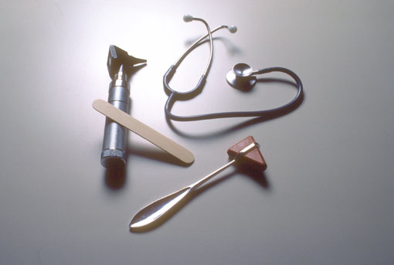
Fleeting nature of human wisdom
2

Slide 16
and

Slide 17
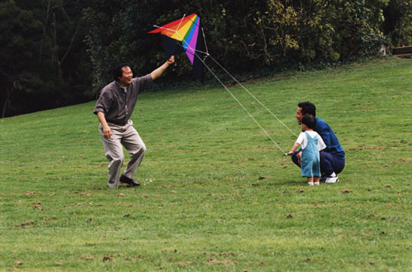
Fleeting nature of youth
3

Slide 18
Ecclesiastes Overview
403
Notes:
But now the subject shifts into the third fleeting area in the final section of the book.
This time it’s about youth (explain book chart).

Slide 19
Life has three stages
What should youth pursue in life?
Focus on 2 pursuits
Youth 0-30
Youth 0-30
Eccl. 11:7 –12:7
Notes:
This passage specifically shows two pursuits every youth should have. However, it actually relates to all of us, whether youth or not. Even if you are not a youth, you certainly relate to youth and can help them with this passage. This means that you are closer to aging, which this passage also addresses!
Solomon gives us God’s two key priorities for youth in Ecclesiastes 11:7–12:7. Let’s listen in!

Slide 20
I. Enjoy life now before judgment and death comes (11:7-10).
Notes:
Live each day with joy because you’ll account for it and it might be your last.

Slide 21
Enjoy your whole life now before death comes (11:7-8).

Slide 22
"Light is sweet; how pleasant to see a new day dawning" (11:7 NLT).
Notes:
Living is pleasant and good (11:7).

Slide 23
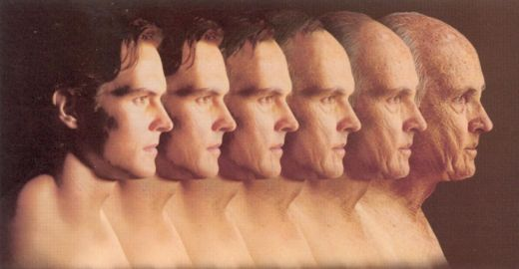
"When people live to be very old, let them rejoice in every day of life. But let them also remember there will be many dark days. Everything still to come is meaningless [or obscure]" (11:8 NLT).
Notes:
Enjoy life into your old age (11:8a).
Live responsibly because after death is eternity (11:8b).
The future after death is obscure (11:8c).
(However, some of us are youth, so how can youth enjoy life?)

Slide 24
Enjoy your youth in light of God's judgment (11:9-10).
Notes:
[Pursue life’s opportunities realizing that you’ll account to God for each.]

Slide 25
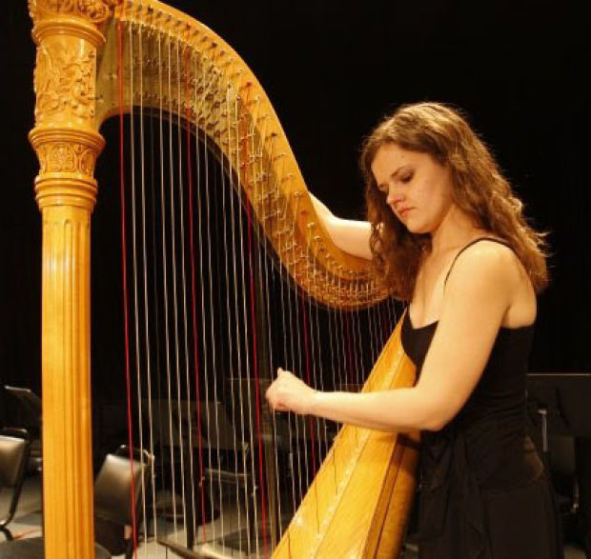
"Young people, it's wonderful to be young! Enjoy every minute of it" (11:9a NLT).
Notes:
Enjoy your childhood and youth (11:9a).

Slide 26
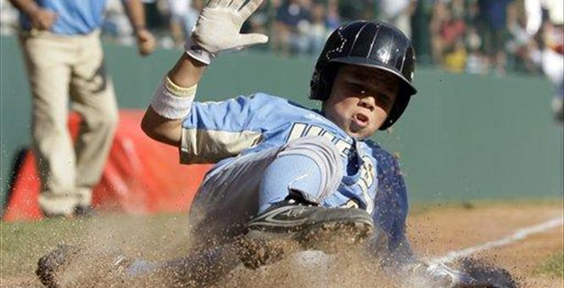
"Do everything you want to do; take it all in" (11:9b NLT).
Notes:
Do what you like and pursue what you see (11:9b).

Slide 27
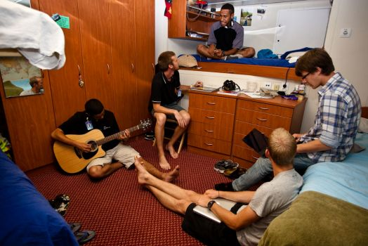
Logos Hope
Notes:
Travel to share the gospel as many places as you can—like on Logos Hope.

Slide 28
The Crossroads (1981-83)
Notes:
After college it seemed the natural thing to do to join Campus Crusade staff in the Philippines on a seven-member music team.

Slide 29
Crossroads Ministry
Korea
China
Japan
Hong Kong
Taiwan
Macau
Thailand
Philippines
Malaysia
Singapore
Indonesia
Notes:
The Crossroads team shared the gospel in 11 Asian nations. We sang 269 concerts and saw over 10,000 people indicate decisions to trust Christ!

Slide 30
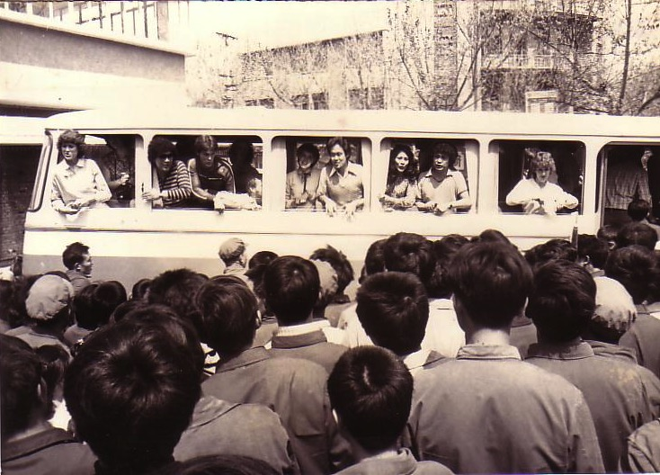
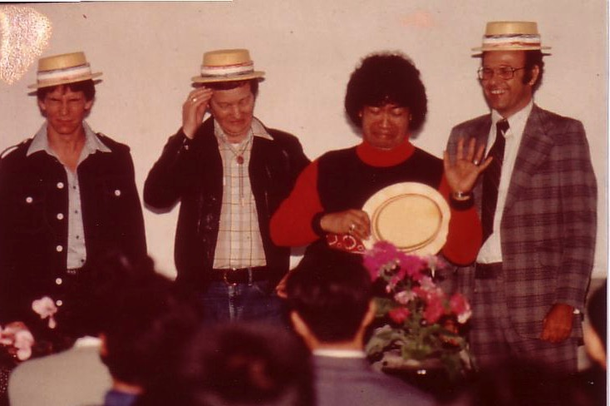
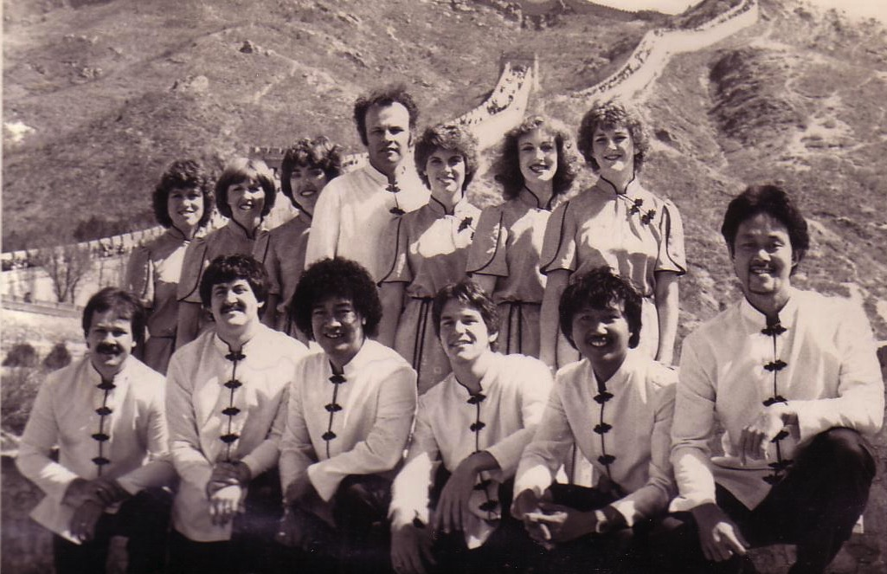
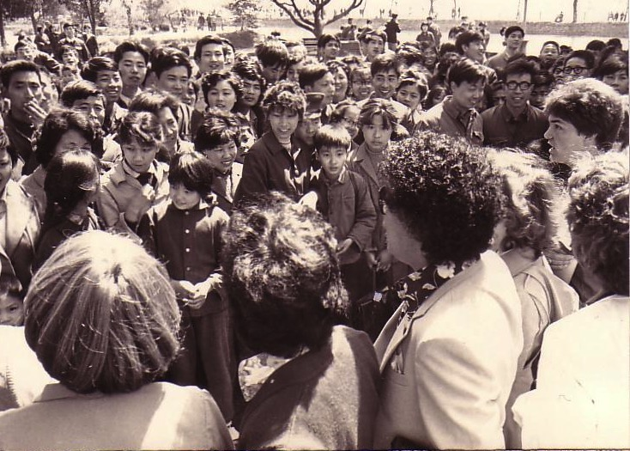
China, 1981
Notes:
On our first tour to China we were the first Christian musical team to visit the New China. We sang in music conservatories, parks, and even from the bus! God began to open my eyes to the needs of East Asia…

Slide 31
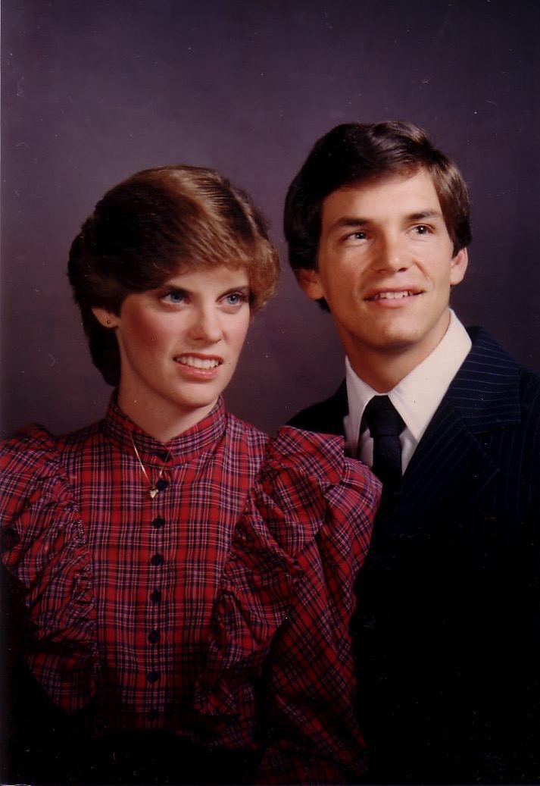
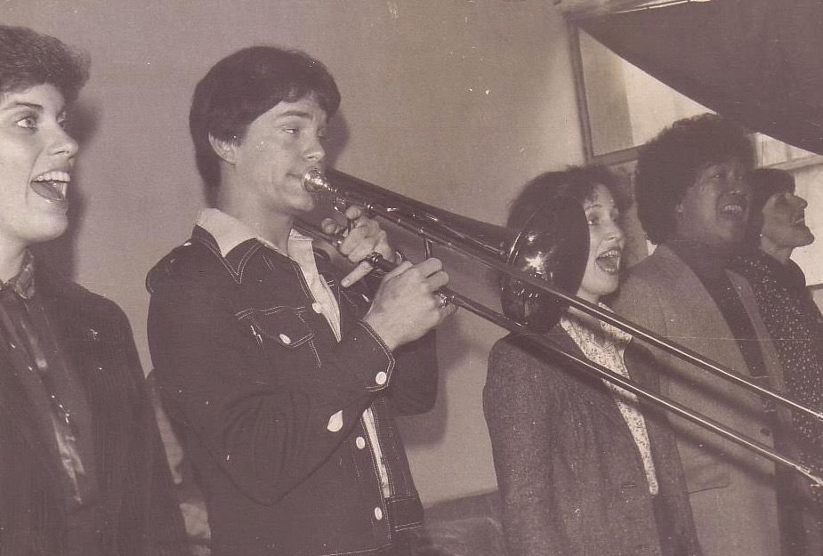
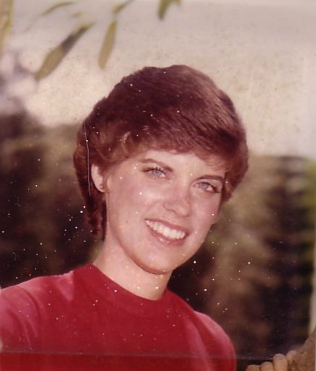
Romance, 1982
Notes:
God also began to open my eyes to the woman singing next to me! She initially despised me but after a year or so she saw the light. That's our engagement picture. In 1983 we returned to the USA.
My advice? Don’t get married until your mid-20s. Marriage is great—but it can wait!

Slide 32
"But remember that you must give an account to God for everything you do" (11:9c NLT).
Notes:
Yet realize that God will judge your choices in life (11:9c).
God knows that the most important decisions in life we make when we are young—so he wants this passage to set the trajectory for our lives on the right course. God will hold you accountable for the decisions you make.

Slide 33
Singpu in Myanmar
Notes:
This week our Burmese member Singpu sent a report of a recent conference he conducted in Myanmar.

Slide 34
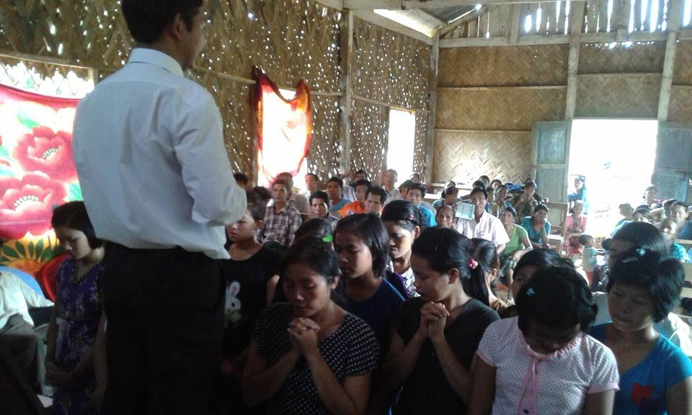
Singpu in Myanmar
Notes:
He saw 24 young people come to Christ!

Slide 35
Singpu in Myanmar
Notes:
In fact, 80% of people who become Christians do so before age 18.

Slide 36
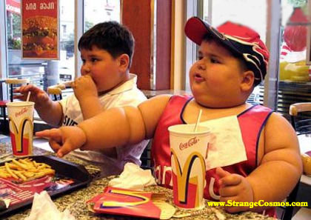
"So refuse to worry, and keep your body healthy" (11:10a NLT).
Notes:
Refuse to worry and keep your body healthy (11:10a).

Slide 37
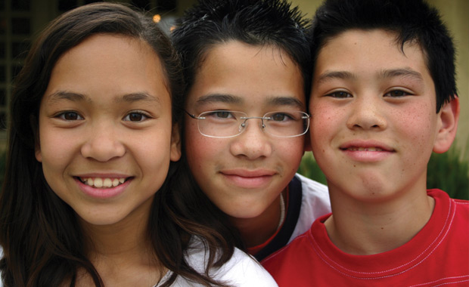
"But remember that youth, with a whole life before you, is meaningless ["fleeting" NAU]" (11:10b NLT).
Notes:
Yet know that youthful energy won’t last (11:10b).

Slide 38
Life has three stages
What should youth pursue in life?
Focus on 2 pursuits
Youth 0-30
Youth 0-30
Eccl. 11:7 –12:7
Notes:
I noted at the beginning that this passage gives two pursuits every youth should have.

Slide 39
I. Enjoy life now before judgment and death comes (11:7-10).
Notes:
We saw first that God wants youth—and all of us—to enjoy life. But what else should youth pursue besides fun? In other words, how are youth to enjoy life? The way to really enjoy your youth is to…

Slide 40
II. Honor God as Creator before you grow old and die (12:1-7).
Notes:
Respect the Lord as a young person because you soon will be elderly.

Slide 41
"Don't let the excitement of youth cause you to forget your Creator. Honor him in your youth before you grow old and say, 'Life is not pleasant anymore'" (12:1 NLT).
"Remember also your Creator in the days of your youth…" (12:1 NAU).
Notes:
Honor your Creator now.

Slide 42
One day at the dentist…
Notes:
Have you ever been guilty of looking at others your own age and thinking, surely I can't look that old? One woman writes…
My name is Alice, and I was sitting in the waiting room for my first appointment with a new dentist.
I noticed his DDS diploma on the wall, which bore his full name. Suddenly, I remembered a tall, handsome, dark-haired boy with the same name had been in my high school class some 30-odd years ago.
Could he be the same guy that I had a secret crush on, way back then?
Upon seeing him, however, I quickly discarded any such thought.
This balding, gray-haired man with the deeply lined face was way too old to have been my classmate.
After he examined my teeth, I asked him if he had attended Morgan Park High School…
“Yes, yes, I did. I’m a mustang,” he gleamed with pride.
“When did you graduate?” I asked.
He answered, “In 1975. Why do you ask?”
“You were in my class!” I exclaimed.
He looked at me closely.
Then, that ugly, old, bald, wrinkled-faced, fat, gray-haired, decrepit, man asked,
“What did you teach???”

Slide 43
"The command 'Remember your Creator' means to revere God, to keep His laws faithfully, to serve Him responsibly, remembering that because He created people, everyone owes Him his life.” —Donald Glenn, in The Bible Knowledge Commentary
"Remember also your Creator in the days of your youth…" (12:1 NAU).
Notes:
What does it mean to “remember your creator” (12:1)?
BKC quote above
The opposite, of course, is to forget God—specifically to forget him as Creator…

Slide 44
Foster Letter 2002
"The 'American Family In Crises Research' by the Southern Baptist Council on Family Life uncovered some disturbing facts. Of the children raised in evangelical homes, 88% leave the church at age 18 and never return."
Pastor's Weekly Briefing, Focus on the Family, 26 July 2002, quoted in Gary Foster, The Foster Letter, 10 Aug. 2002, p. 1.
Notes:
Why does Solomon say for youth to “remember your Creator”? Because most don’t!
From Carl Kerby
Following is the entire quote that was in my newsletter. My source was the 7/26/02 issue of Pastor's Weekly Briefing published by the Pastoral Ministries department of Focus on the Family.
American Family In Crises Research by the Southern Baptist Council on Family Life has uncovered some disturbing facts that are leading the group to emphasize the need to rebuild the American family.
§ 88% of the children raised in evangelical homes leave church at the age of 18, never to return.
§ The divorce ratio among members of evangelical churches is virtually the same as non-church members.
§ One million children in the U.S. see their parents divorce.
§ Personal bankruptcies are at an all-time high in America.
The majority of children in America have less than 10 minutes of significant and meaningful conversation with their parents each week. If you remove the mother, you can measure this statistic in seconds. The council recommends that families set aside one evening a week as a family night, on which no local church activities would be scheduled to interfere. It also urged an increased emphasis on biblically based premarital counseling. (PWB 7/26)
Gary D. Foster
Gary D. Foster Consulting
334 Sutherland Place
Manitou Springs, CO 80829
Phone: 719-685-1138 E-mail: GFosterCns@rmi.net Website: http://www.garydfoster.com/
"Helping Christian ministries & product companies discover new revenue streams and to better leverage existing ones."

Slide 45
Already Gone 04802
Already Gone
by Ken Ham and Britt Beemer, with Todd Hillard
© Answers in Genesis-USA
Notes:
Ken Ham of Answers in Genesis reports that our kids are actually losing their faith much earlier—as young teenagers, in fact.

Slide 46
High school attended
Catholic school
0.6%
Charter school
3.2%
Home school
3.4%
Christian school
6.9%
Public school
85.9%
Notes:
Survey done by American Research Group (similar to Barna and Gallup)—professional statistically valid study paid for by AiG supporters
Survey 20-29 year olds who grew up in church but don't go to church any more, to find out why.

Slide 47
If you don't believe, when did you first have doubts?
Don't know
1.61%
Elementary school
4.37%
College
10.57%
Middle school
39.77%
High school
43.68%

Slide 48
Which of these makes you question the Bible the most?
45.2%
Miracles not true
4.3%
Bible not make sense
10.7%
Creation account
11.2%
Too many rules
14.4%
Earth not 10K yrs
29.7%
None
25.6%
Those Who Often Attended Sunday School

Slide 49
Which of these makes you question the Bible the most?
32.1%
Miracles not true
0.8%
Bible not make sense
11.7%
Creation account
13.5%
Too many rules
10.7%
Earth not 10K yrs
17.8%
None
43.4%
Those Who Rarely Attended Sunday School
Notes:
We are not saying that we should get rid of Sunday school. But we are suggesting that we need to change the curriculum and the training.
Most Sunday school teachers, like most Christian adults don't know how to defend the faith against the skeptical challenges that are coming through the schools, media, science programs on TV, etc. We need apologetics training for the teachers and then they need to give it to the kids.

Slide 50
Psalm 11:3 NAS
Psalm 11:3
If the foundations are destroyed, what can the righteous do?

Slide 51
HONOR
The difference between the good guys and the bad guys is whether they use human shields or make themselves human shields.

Slide 52
HONORING GOD
The difference between the good guys and the bad guys is whether they want God to honor them or they want to honor God.
Notes:
I agree, but I’d tweak it a bit, as the difference between the good guys and the bad guys is whether they want God to honor them or they want to honor God.

Slide 53
As youth, we think we'll always be invincible
Notes:
(But why honor him now? As youth, we think we’ll always be invincible—but your life will pass faster than you can ever imagine! So chapter 12 begins by telling youth…)

Slide 54
Honor your Creator now before you have the limits of old age (12:1-5e).

Slide 55
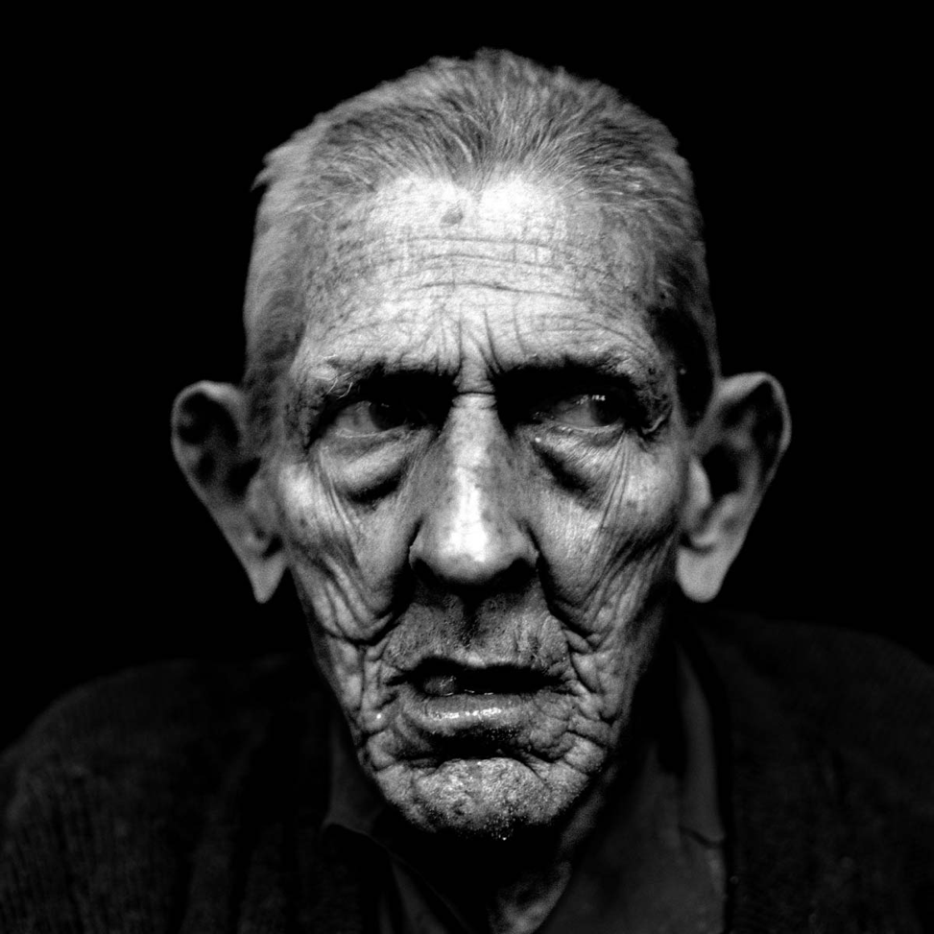
"before the sun and the light, the moon and the stars are darkened, and clouds return after the rain" (12:2 NAU).
"Remember him before the light of the sun, moon, and stars is dim to your old eyes, and rain clouds continually darken your sky" (12:2 NLT).
Notes:
The elderly lose perspective (12:1-2):
• Honor God now before you can't see well or enjoy life (12:1-2a).
• The elderly are often gloomy (12:2b).

Slide 56
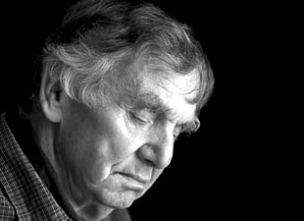
Elderly Gloom
Notes:
Research shows that elderly depression is a common, widespread problem. Adults over age 60 are five times more likely to be depressed or suicidal than younger people.
To fight gloom, it’s like me giving my wife the promise that…
http://www.beliefnet.com/Health/galleries/Old-and-Depressed-The-Not-So-Golden-Years.aspx#FjzGjWUit1iwiCM2.99

Slide 57
Senility

Slide 58
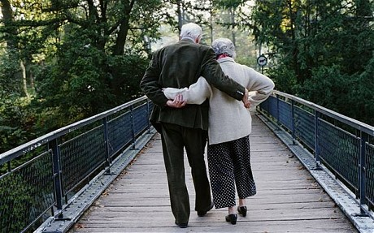
The elderly slow down physically until they die (12:3-4).

Slide 59
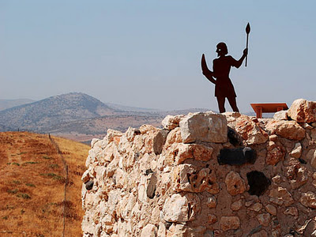
"in the day that the watchmen of the house tremble" (12:3a NAU).
"Remember him before your legs—the guards of your house —start to tremble" (12:3a NLT).
Notes:
Their legs and arms tremble with age (12:3a)

Slide 60
"and mighty men stoop" (12:3b NAU).
"and before your shoulders—the strong men—stoop" (12:3b NLT).
Notes:
Their spine curves so they walk bent over (12:3b)

Slide 61
"the grinding ones stand idle because they are few" (12:3c NAU).
"Remember him before your teeth—your few remaining servants—stop grinding" (12:3c NLT).
Notes:
Their teeth fall out with too few to chew properly (12:3c).

Slide 62
Black
Notes:
Chewing has always been a problem for the elderly.
Fortunately, someone has invented a bottle opener shaped like teeth that the elderly can use to get things done faster!

Slide 63
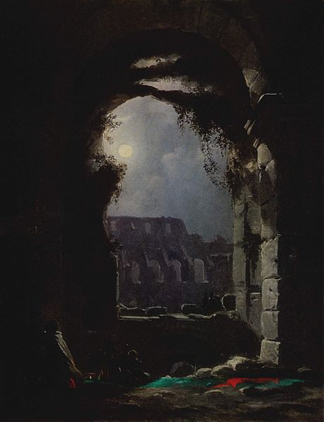
"and those who look through windows grow dim" (12:3d NAU).
"and before your eyes—the women looking through the windows—see dimly" (12:3d NLT).
Notes:
Their eyes can hardly see (12:3d).

Slide 64
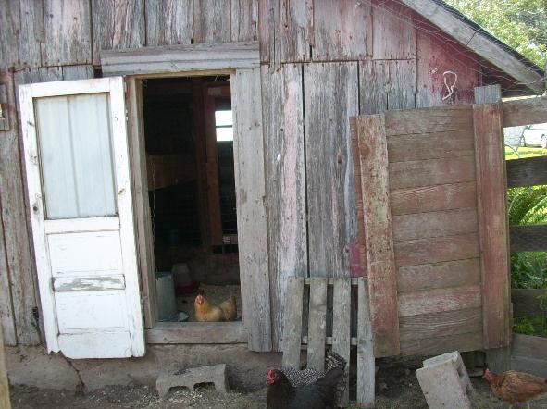
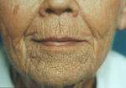
"and the doors on the street are shut as the sound of the grinding mill is low" (12:4a NAU).
"Remember him before the door to life's opportunities is closed and the sound of work fades" (12:4a NLT).
Notes:
Their pursed lips enclose teeth that chew slowly (12:4a).

Slide 65
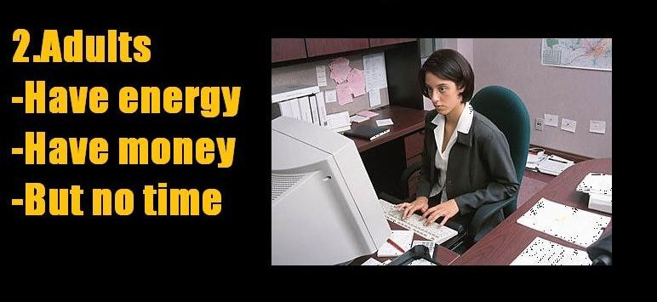
Life has three stages
Notes:
Remember when I noted that life has three stages? Here’s another depiction…

Slide 66
"and one will arise at the sound of the bird" (12:4b NAU).
"Now you rise at the first chirping of the birds" (12:4b NLT).
Notes:
Their ability to sleep is disturbed by a tiny noise (12:4b).

Slide 67
"and all the daughters of song will sing softly" (12:4c NAU).
"but then all their sounds will grow faint" (12:4c NLT).
Notes:
Ironically, their hearing is impaired (12:4c).

Slide 68
COURAGE
is contagious

Slide 69
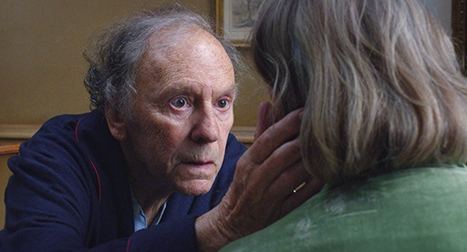
The elderly lose courage and ability (12:5a-e).

Slide 70
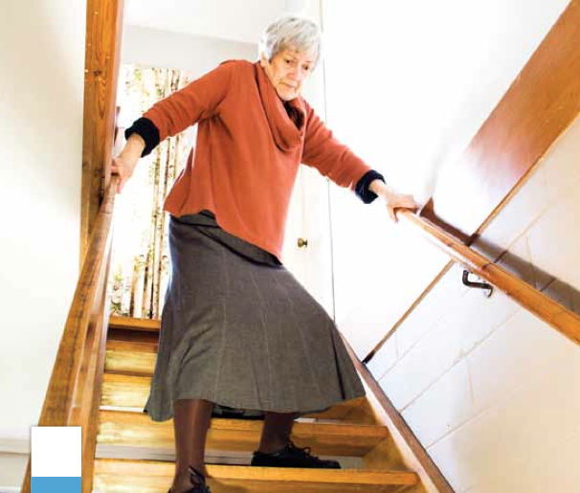
"Furthermore, men are afraid of a high place" (12:5a NAU).
"Remember him before you become fearful of falling" (12:5a NLT).
Notes:
Their lack of balance causes a fear of high places (12:5a).

Slide 71
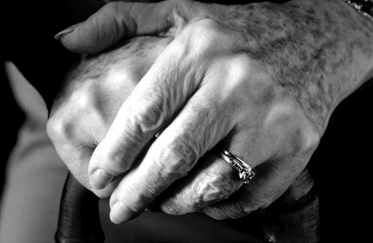
"and of terrors on the road" (12:5b NAU).
"and worry about danger in the streets" (12:5b NLT).
Notes:
Their sense of adventure turns into staying home (12:5b).

Slide 72
Sometimes our worry is that we are living too long!
You told me you’d spend your whole life trying to make me happy.
I’d didn’t expect to live this long.

Slide 73
We Live Way Longer Than We Expect And that could be bad news post-retirement
Notes:
By Arden Dier, Newser Staff
http://www.newser.com/story/198626/we-live-way-longer-than-we-expect.html
In fact, a study came out this week that shows that most people are living longer than they expected! Half thought they’d die before 75 but they didn’t!
(Newser) – How long do you think you'll live? New research suggests you can tack a few more years on to whatever number you came up with. In 1992, University of Michigan researchers asked 26,000 Americans between the ages of 51 and 61 if they thought they would make it to 75. Some 22 years later, researchers with the Brookings Institution crunched the data and found people tend to underestimate how many years they have left. Of those born between 1931 and 1934, a full 49% who said they wouldn't see 75 were wrong. In fact, almost all that group's respondents, except those who gave themselves 90% or better odds of making it to 75, turned out to have been overly pessimistic, the Wall Street Journal reports.
It's more than just an interesting stat: With the dwindling state of Social Security, researchers worry people won't save enough money to cover the possibility that they'll live longer than they expect, Phys.org reports. "Individuals do not fully understand the longevity risk they face," the authors explain. A longevity annuity could be a solution: An individual hands over a chunk of cash and begins receiving payments after a set number of years. The researchers outline what $100,000 spent on an annuity by a 60-year-old male could result in: $1,052 monthly payments beginning at 70, or $2,539 payments if the purchaser waited until 80 to collect. (Your nose may offer a clue to your longevity.)

Slide 74
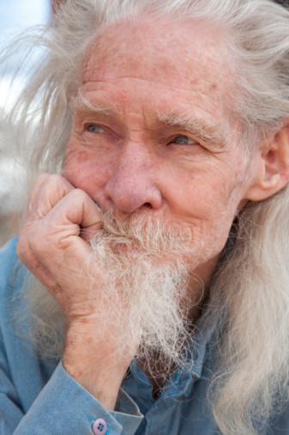
"the almond tree blossoms" (12:5c NAU).
"before your hair turns white like an almond tree in bloom" (12:5c NLT).
Notes:
Their hair turns white or gray (12:5c).

Slide 75
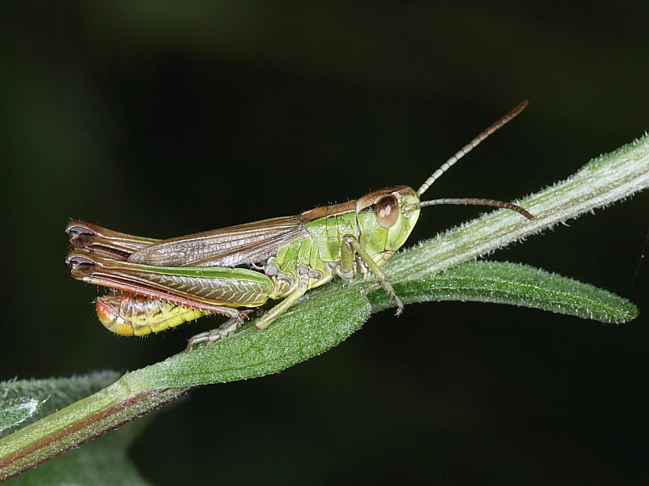
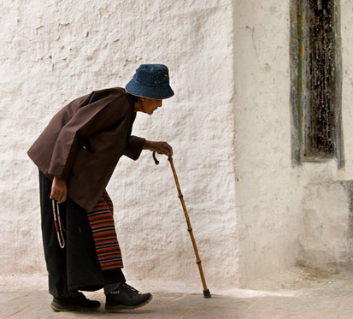
"the grasshopper drags himself along" (12:5d NAU).
"and you drag along without energy like a dying grasshopper" (12:5d NLT).
Notes:
Their feeble legs make them move slowly (12:5d).

Slide 76
"and the caperberry is ineffective" (12:5e NAU).
"and the caperberry no longer inspires sexual desire" (12:5e NLT).
Notes:
Their desires to do things diminish (12:5e).

Slide 77
Old folks tire easily

Slide 78
Honor your Creator now before death comes (12:5f-7).

Slide 79
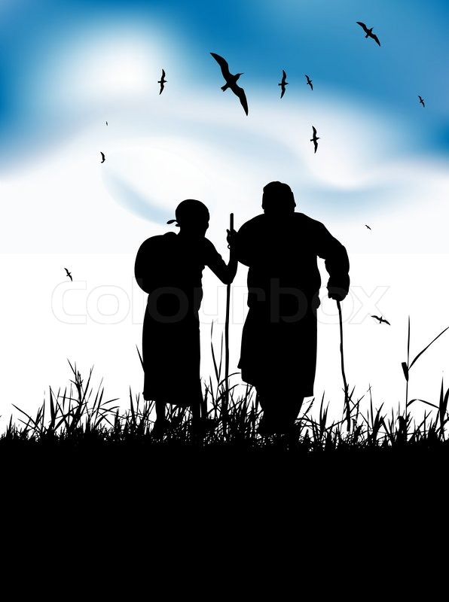
"Remember him before you near the grave, your everlasting home, when the mourners will weep at your funeral" (12:5f NLT).
Notes:
At death people enter eternity but others mourn their loss (12:5f).

Slide 80
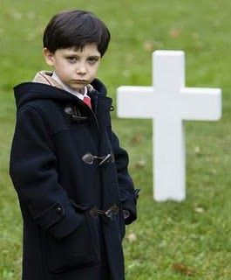
Death is permanent (12:6).

Slide 81
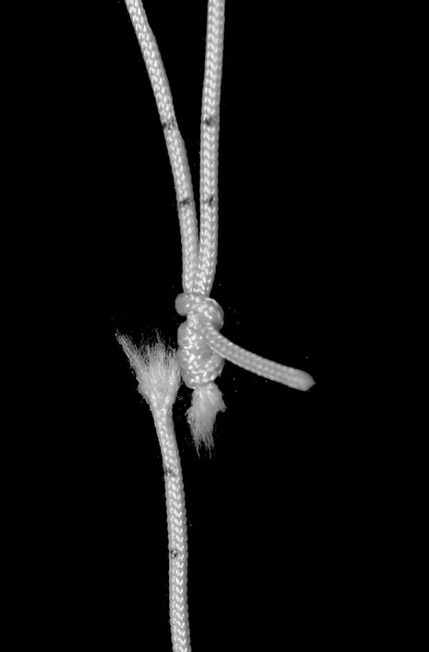
"Yes, remember your Creator now while you are young, before the silver cord of life snaps" (12:6a NLT).
Notes:
Death is like a broken cord, never fixed again (12:6a).

Slide 82
"…and the golden bowl is broken" (12:6b NLT).
Notes:
Death is like a broken bowl, never fixed again (12:6b).

Slide 83
"Don't wait until the water jar is smashed at the spring" (12:6c NLT).
Notes:
Death is like a broken pitcher, never fixed again (12:6c).

Slide 84
"and the pulley is broken at the well" (12:6d NLT).
Notes:
Death is like a broken pulley, never fixed again (12:6d).

Slide 85
At death the body and spirit go opposite ways to their origins (12:7).

Slide 86
Adam came from dust (Gen. 2:7).

Slide 87
"For then the dust will return to the earth" (12:7a NLT).
Notes:
The body returns to the dust from where it came (12:7a).

Slide 88
"and the spirit will return to God who gave it" (12:7b NLT).
Notes:
The spirit returns to God from whom it came (12:7b; cf. Gen. 2:7).

Slide 89
How to Enjoy Your Youth
Ecclesiastes 11:7–12:7

Slide 90
The way to enjoy your youth is to honor God
Main Idea

Slide 91
Life has three stages
What should youth pursue in life?
Focus on 2 pursuits
Youth 0-30
Youth 0-30
Eccl. 11:7 –12:7
Notes:
Solomon advises youth to have two pursuits:

Slide 92
I. Enjoy life now before judgment and death comes (11:7-10).
Notes:
However, the way to enjoy life is to…

Slide 93
II. Honor God as Creator before you grow old and die (12:1-7).
Notes:
Remember Him!

Slide 94
We all are terminal.
Old people at weddings always poke me and say, “You’re next.” So, I started doing the same thing to them at funerals.

Slide 95
A palliative care nurse sums up "The Top Five Regrets People Make on Their Deathbed"
I wish I had the courage to live a life true to myself, not the life others expected of me.
I wish I didn't work so hard.
I wish I had the courage to express my feelings.
I wish I had stayed in touch with my friends.
I wish that I had let myself be happier.
Notes:
Imagine yourself on your deathbed. What regrets do you think you might have? How might you wish you had used your life differently?
A nurse named Bronnie Ware recently wrote an article entitled, “The Top Five Regrets People Make on Their Deathbed.” What are these 5 regrets?
________
For many years I worked in palliative care. My patients were those who had gone home to die. Some incredibly special times were shared. I was with them for the last three to twelve weeks of their lives. People grow a lot when they are faced with their own mortality.
I learnt never to underestimate someone’s capacity for growth. Some changes were phenomenal. Each experienced a variety of emotions, as expected, denial, fear, anger, remorse, more denial and eventually acceptance. Every single patient found their peace before they departed though, every one of them.
When questioned about any regrets they had or anything they would do differently, common themes surfaced again and again. Here are the most common five:
1. I wish I’d had the courage to live a life true to myself, not the life others expected of me.
This was the most common regret of all. When people realize that their life is almost over and look back clearly on it, it is easy to see how many dreams have gone unfulfilled. Most people had not honoured even a half of their dreams and had to die knowing that it was due to choices they had made, or not made.
It is very important to try and honour at least some of your dreams along the way. From the moment that you lose your health, it is too late. Health brings a freedom very few realise, until they no longer have it.
2. I wish I didn’t work so hard.
This came from every male patient that I nursed. They missed their children’s youth and their partner’s companionship. Women also spoke of this regret. But as most were from an older generation, many of the female patients had not been breadwinners. All of the men I nursed deeply regretted spending so much of their lives on the treadmill of a work existence.
By simplifying your lifestyle and making conscious choices along the way, it is possible to not need the income that you think you do. And by creating more space in your life, you become happier and more open to new opportunities, ones more suited to your new lifestyle.
3. I wish I’d had the courage to express my feelings.
Many people suppressed their feelings in order to keep peace with others. As a result, they settled for a mediocre existence and never became who they were truly capable of becoming. Many developed illnesses relating to the bitterness and resentment they carried as a result.
We cannot control the reactions of others. However, although people may initially react when you change the way you are by speaking honestly, in the end it raises the relationship to a whole new and healthier level. Either that or it releases the unhealthy relationship from your life. Either way, you win.
4. I wish I had stayed in touch with my friends.
Often they would not truly realise the full benefits of old friends until their dying weeks and it was not always possible to track them down. Many had become so caught up in their own lives that they had let golden friendships slip by over the years. There were many deep regrets about not giving friendships the time and effort that they deserved. Everyone misses their friends when they are dying.
It is common for anyone in a busy lifestyle to let friendships slip. But when you are faced with your approaching death, the physical details of life fall away. People do want to get their financial affairs in order if possible. But it is not money or status that holds the true importance for them. They want to get things in order more for the benefit of those they love. Usually though, they are too ill and weary to ever manage this task. It is all comes down to love and relationships in the end. That is all that remains in the final weeks, love and relationships.
5. I wish that I had let myself be happier.
This is a surprisingly common one. Many did not realise until the end that happiness is a choice. They had stayed stuck in old patterns and habits. The so-called ‘comfort’ of familiarity overflowed into their emotions, as well as their physical lives. Fear of change had them pretending to others, and to their selves, that they were content. When deep within, they longed to laugh properly and have silliness in their life again. When you are on your deathbed, what others think of you is a long way from your mind. How wonderful to be able to let go and smile again, long before you are dying.
Life is a choice. It is YOUR life. Choose consciously, choose wisely, choose honestly. Choose happiness.
_____________
Source: This article originated from blog of author Bronnie Ware at http://inspirationandchai.com/Regrets-of-the-Dying.html.
Based on this article, Bronnie has released a full-length book. It is a memoir of her own life and how it was transformed based on the regrets of the dying people she cared for. The book is available from her website http://www.bronnieware.com and major online bookstores and is called ‘The Top Five Regrets of the Dying – A Life Transformed by the Dearly Departing’.

Slide 96
An Ecclesiastes Paraphrase
I wish I had sought God's plan for my life.
I wish I put my energy into eternal priorities.
I wish I were honest with God about how I felt.
I wish I cared for people more than things.
I wish I had found my joy in God.
Notes:
This nurse isn’t a Christian, so she gives a secular way of saying what Solomon says here in Ecclesiastes. I would paraphrase what this nurse is saying as [above compared to below]
I wish I had the courage to live a life true to myself, not the life others expected of me.
I wish I didn’t work so hard.
I wish I had the courage to express my feelings.
I wish I had stayed in touch with my friends.
I wish that I had let myself be happier.
Which of these would you most likely say on your deathbed, given your present state in life?
Put a mark by it in your notes and commit it to prayer.

Slide 97
Black

Slide 98
OT Preaching link at BibleStudyDownloads.org
Get this presentation and script for free!

